Slide 1

AI AGENT FOR IDENTIFYING LEAF DISEASES IN CROPS (Planter)
Mentor/S : K.M.K.S.Karunanayake
Internal Supervisor/S : Mr P Vigneshwaran
Presenter : A.I.Hewarathna
17APC3081
Department of Computing & Information Systems
Mini Project – IS 31230

Slide 2

Content
Introduction
Proposed Functionalities
Current Progress
Future Works
Project Demonstration
2021
Mini Project – IS 31230

Slide 3
Introduction
An application to identify leaf diseases in crops.
Model creation and integration them into android application.
This application can identify 12 plant types (initially 9) and common diseases.
Identifying potential diseases in early-stage and propose solutions.
2021
Mini Project – IS 31230

Slide 4
Proposed Functionalities
AI based leaf disease identification
Disease knowledge base
Cultivation and pest control advices from experts.
Works in even offline(disease detection).
Weed control.
2021
Mini Project – IS 31230
Notes:
‹#›

Slide 5
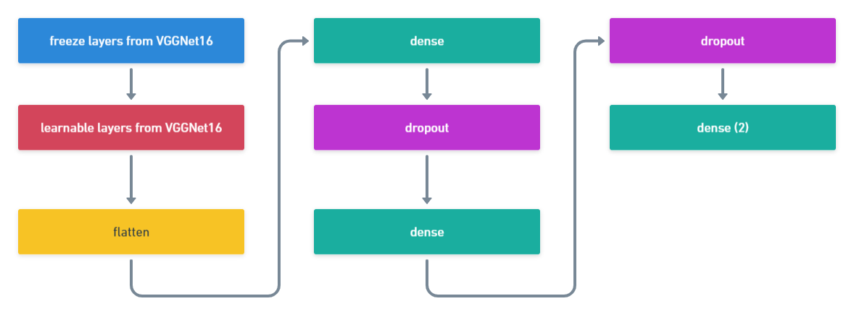
Current Progress: Identification models (plant or not)
final model architecture for plant detector
2021
Mini Project – IS 31230

Slide 6
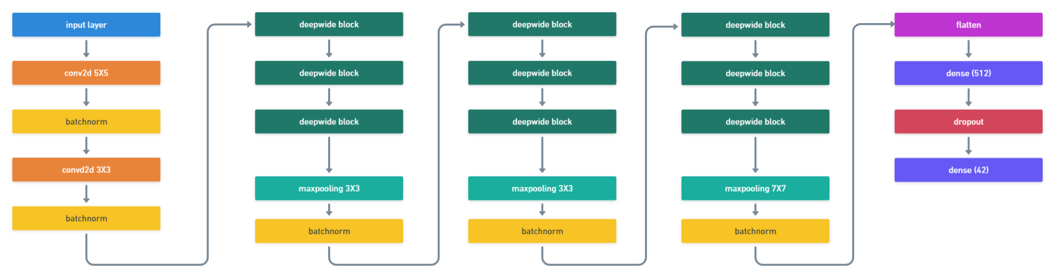
Current Progress: Identification models (disease identification)
final model architecture of leaf disease classifier
2021
Mini Project – IS 31230

Slide 7
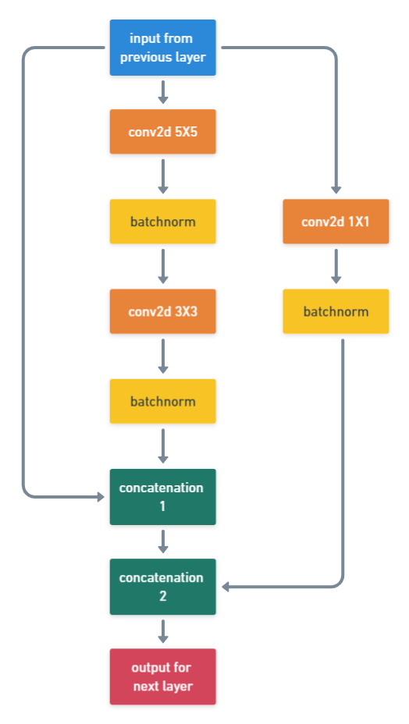
Current Progress: Identification models (disease identification)
DeepWide block architecture of leaf disease classifier
2021
Mini Project – IS 31230

Slide 8

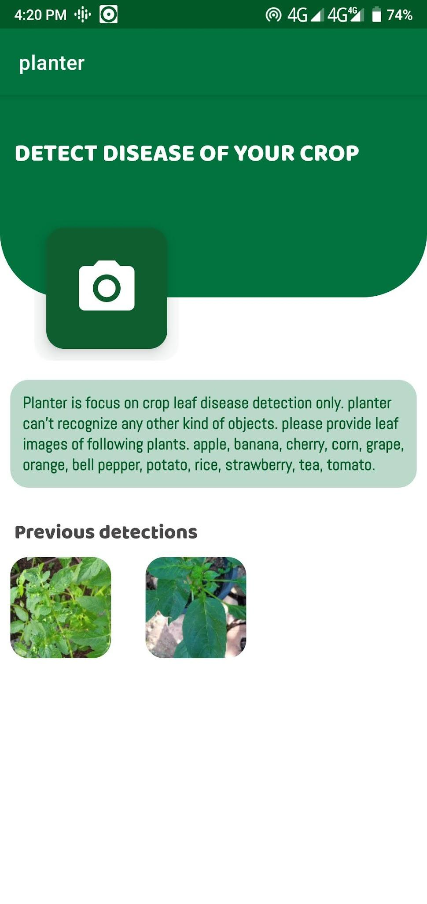
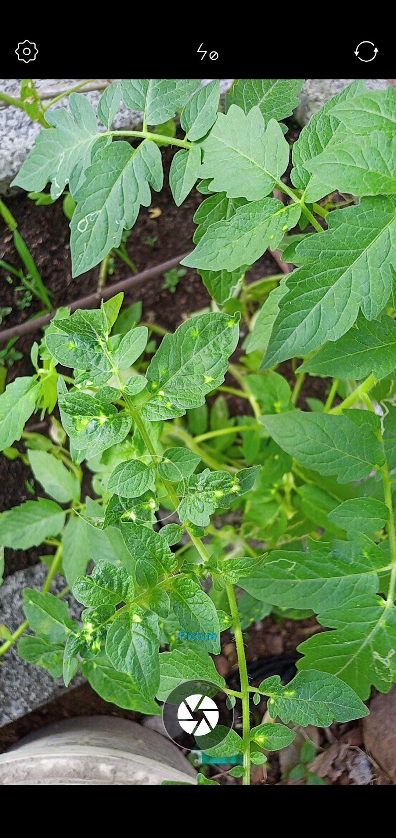
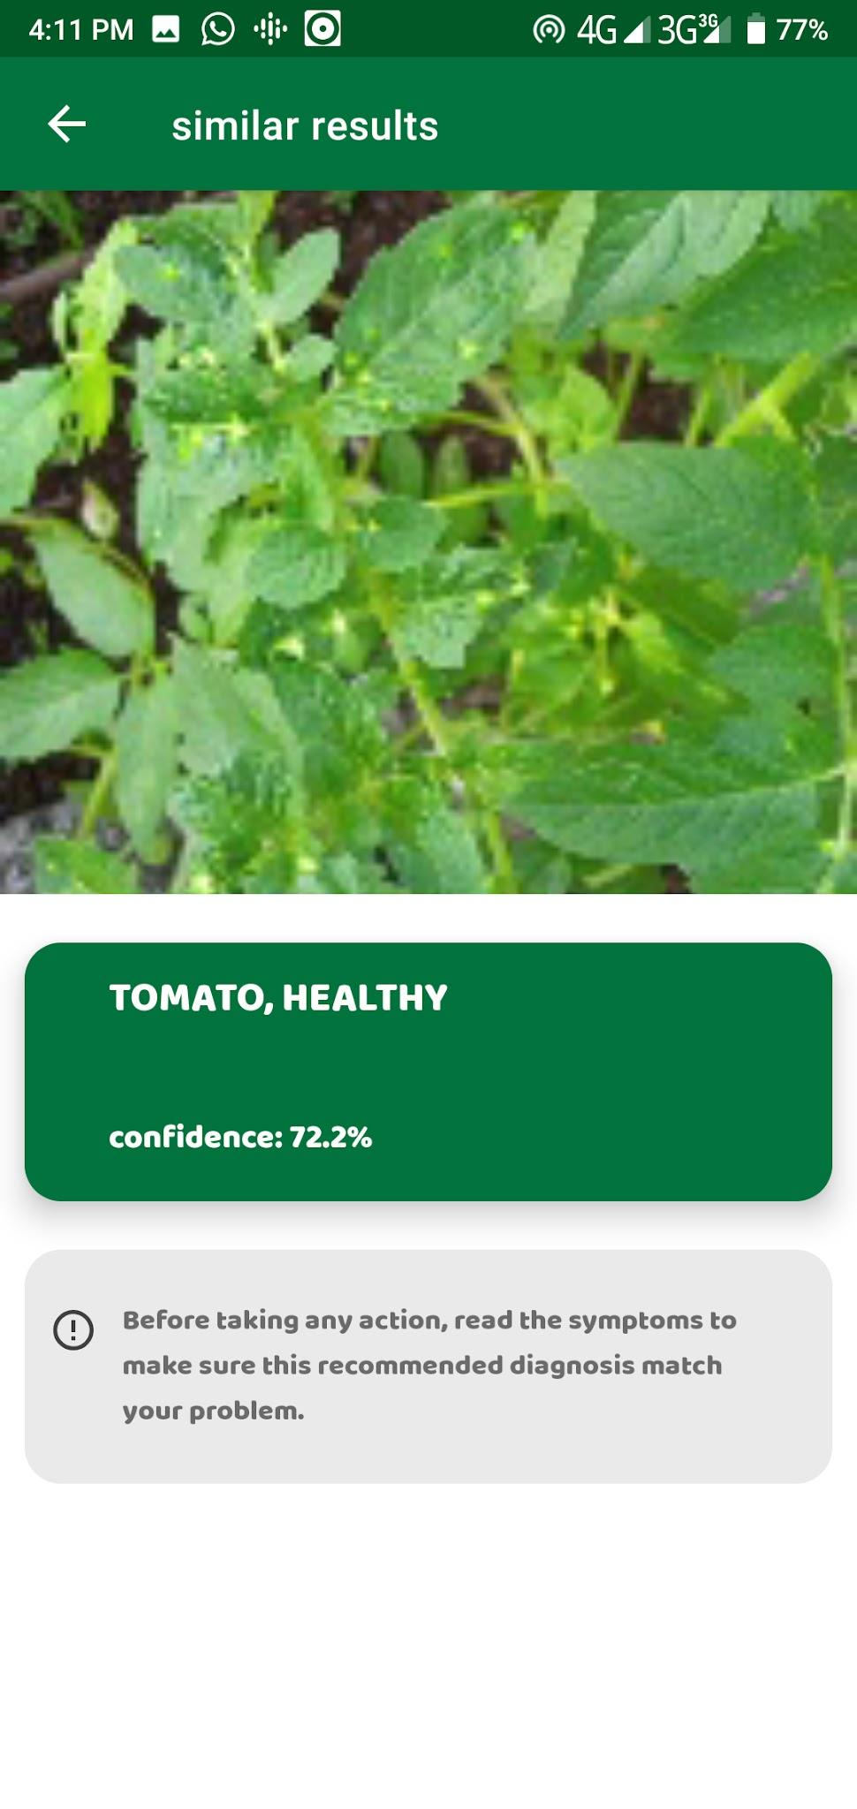
Current Progress: Application
2021
Mini Project – IS 31230

Slide 9
Current Progress: Application
Both models are completed.
Application approximately 75% completed which initially proposed.
2021
Mini Project – IS 31230

Slide 10
Future Work
Weed detector
Cultivation tip provider
2021
Mini Project – IS 31230

Slide 11
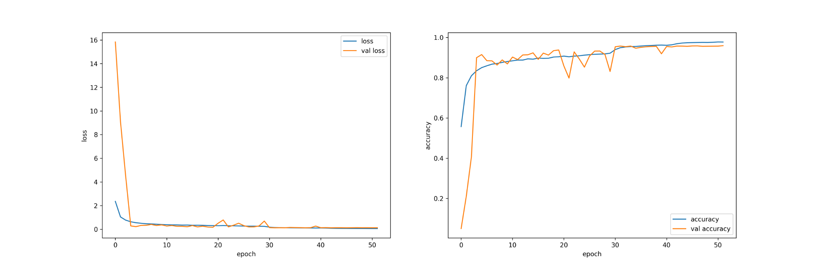
Project Demonstration
leaf disease identifier model learning history
2021
Mini Project – IS 31230

Slide 12
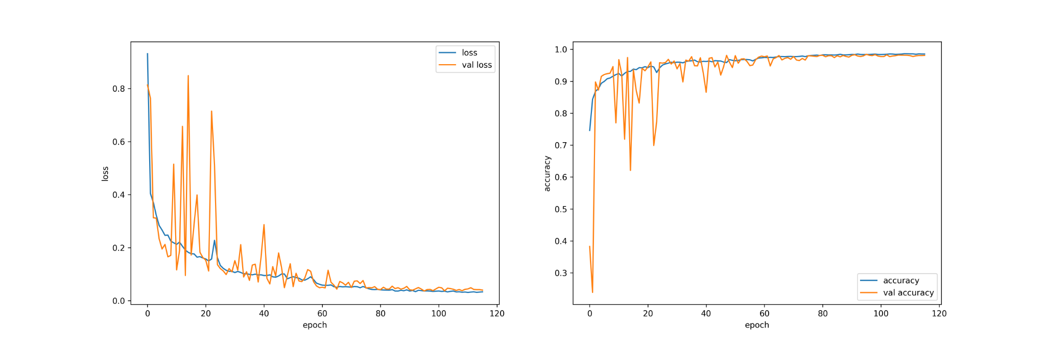
Project Demonstration
is plant in frame identifier model learning history
2021
Mini Project – IS 31230

Slide 13

Project Demonstration
2021
Mini Project – IS 31230

